Slide 1
DATA ANALYSIS ESSENTIALS
Cornerstone Project
GENERIC vs BRANDED MEDICINE PRICE COMPARISON ANALYSIS
REVIEW – 1
SUBMITTED BY
25B11CS406 - K. BHAVYA KIRANMAI – TEAM LEAD
25B11CS298 - G. SRAVANI - DATA&TECH LEAD
25B11CS235 - K. HITESH - IMPLEMENTATION LEAD
25B11CS411 - K. SANTHOSH - QA &STRATEGY
UNDER ESTEEMED GUDANCE OF
Mr. KAKI ASHOK TEJA
ASSISTANT PROFRSSOR
DEPARTMENT OF COMPUTER SCIENCE &ENGINEERING

Slide 2
PROBLEM STATEMENT
Medicine prices can vary significantly between branded and potential generic alternatives with the same or comparable active ingredients.
Differences in strength, dosage form, and pack size can make direct medicine price comparison difficult.
The project groups medicines with comparable active ingredients, strengths, and dosage forms for meaningful comparison.
The project calculates price differences between comparable medicines.
It identifies potential lower-priced alternatives based on the observed medicine prices.

Slide 3
OBJECTIVES
To clean and standardize the medicine dataset for reliable analysis.
To identify comparable medicines based on active ingredient, strength, and dosage form.
To calculate and compare price per unit of medicines with different pack sizes.
To identify potential lower-priced generic alternatives and rank them using price and ingredient-related factors.
To analyze potential price savings between potential generic and branded medicines using tables and visualizations.

Slide 4
DATA SET DETAILS
KAGGLE LINK: https://www.kaggle.com/datasets/rishgeeky/indian-pharmaceutical-products
Dataset Name : Indian Pharmaceutical products Dataset
File Format : CSV
Number of Rows : 253,973
Number of Columns : 15
Important Attributes :
Medicine / Brand Name
Active Ingredient
Strength
Dosage Form
Pack Size
Price
Price-per-unit Calculation

Slide 5
SYSTEM REQUIREMENTS
💻 Hardware Requirements:
Processor : AMD Ryzen 5/intel core i3
RAM : Minimum 4 GB
Storage : Minimum 2 GB free
Internet : Stable Internet
⚙Software Requirements:
Operating System : Windows 10/11
Web Browser : Chrome/Microsoft Edge
Platform : Google colab
Google Account :To accesss google colab.

Slide 6
TECHNOLOGY STACK
Programming Language: Python
Development Environment: Google Colab
Data Processing: Pandas, NumPy
Data Cleaning: Pandas, Regular Expressions (re)
Data Analysis: Pandas, NumPy
Data Visualization: Matplotlib, Seaborn
Dataset Format: CSV
Version Control: Git & GitHub
Project Documentation: Markdown (README.md)

Slide 7
METHODOLOGY
DATASET
↓
🧹 CLEANING
↓
💊 INGREDIENT EXTRACTION
↓
📦 PACK-SIZE NORMALIZATION
↓
₹ PRICE/UNIT
↓
🔎 COMPARISON
↓
📊 RESULTS
BEFORE
Raw medicine data
↓
Different formats
↓
Different pack sizes
↓
Difficult comparison
AFTER
Standardized data
↓
Comparable medicines
↓
Price/unit
↓
Meaningful comparison

Slide 8
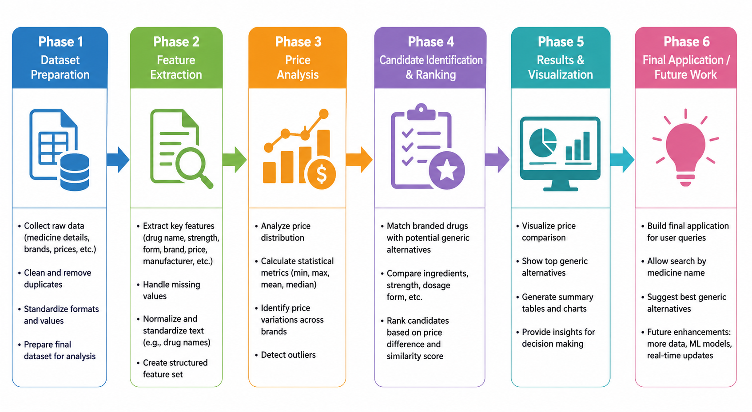
IMPLEMENTATION PLAN

Slide 9
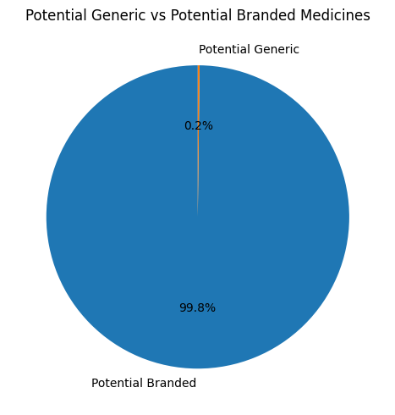
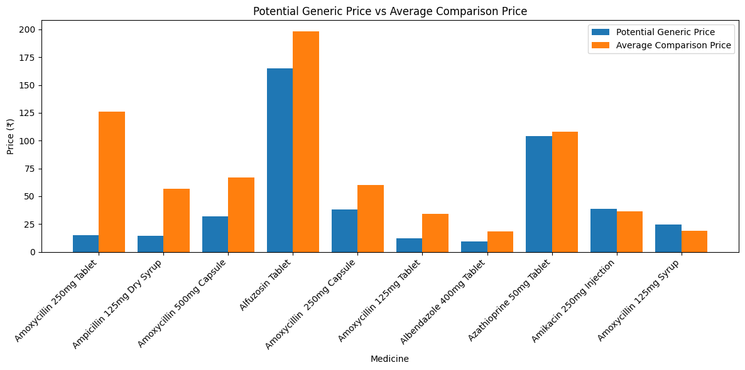
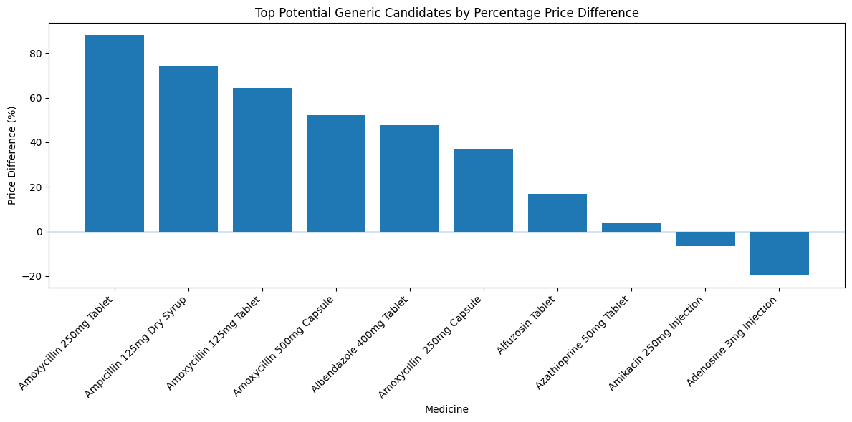
FEW VISUALISATIONS

Slide 10
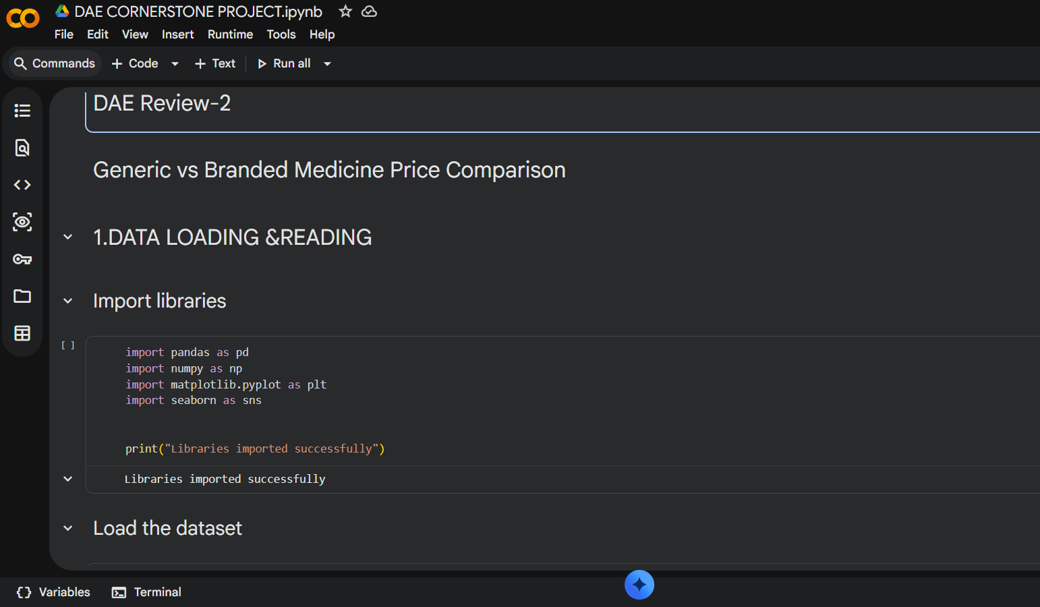
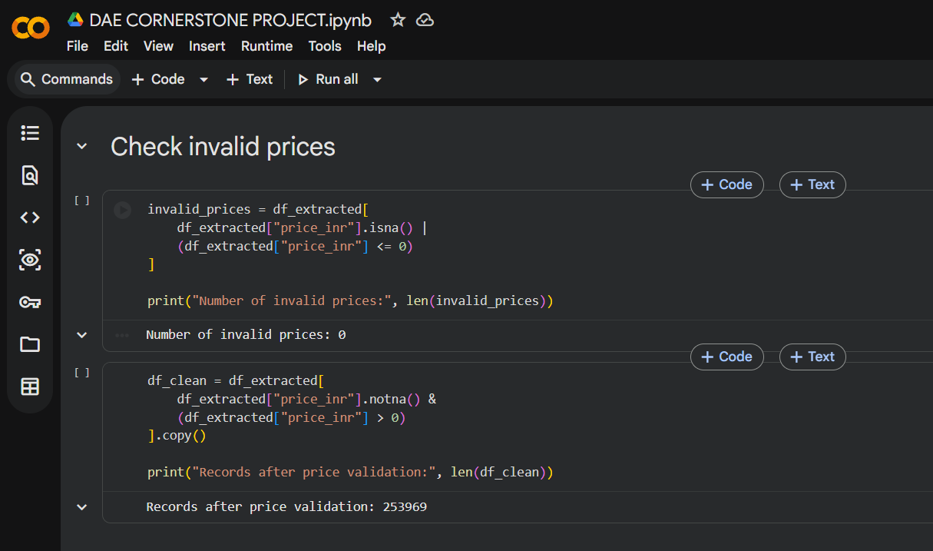
https://colab.research.google.com/drive/1clmeNu17zrfmKnIClhphv4vUFYsfSfpF?usp=sharing

Slide 11

FUTURE ENHANCEMENTS
Develop a user-friendly web/mobile applicationwhere users can search medicines and compare potential lower-priced alternatives.
Integrate reliable and updated medicine data to improve price accuracy and validate potential generic candidates.

Slide 12
CONCLUSION
Developed a data-driven approach to compare medicine prices based on ingredient, strength, dosage form, pack size, and price per unit.
Identified potential lower-priced generic candidates and analyzed their price differences and potential savings.
The project demonstrates how Python-based data analysis and visualization can support easier and more meaningful medicine price comparison.

Slide 13
ThANK YOU

